Slide 1
Computer Graphics Summer ‘19 Project
Bakir Bascelic
Saint Anselm College

Slide 2
Images done in Processing programming language

Slide 3


Slide 4
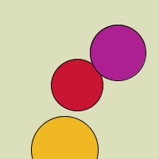

Slide 5


Slide 6


Slide 7


Slide 8


Slide 9
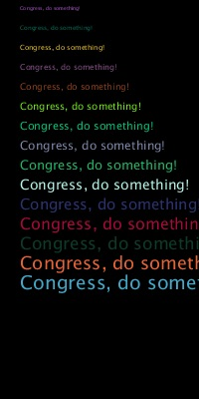

Slide 10


Slide 11


Slide 12


Slide 13
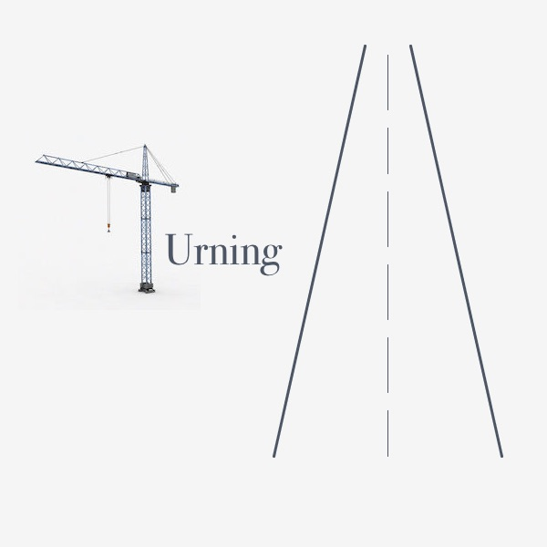

Slide 14


